Slide 1

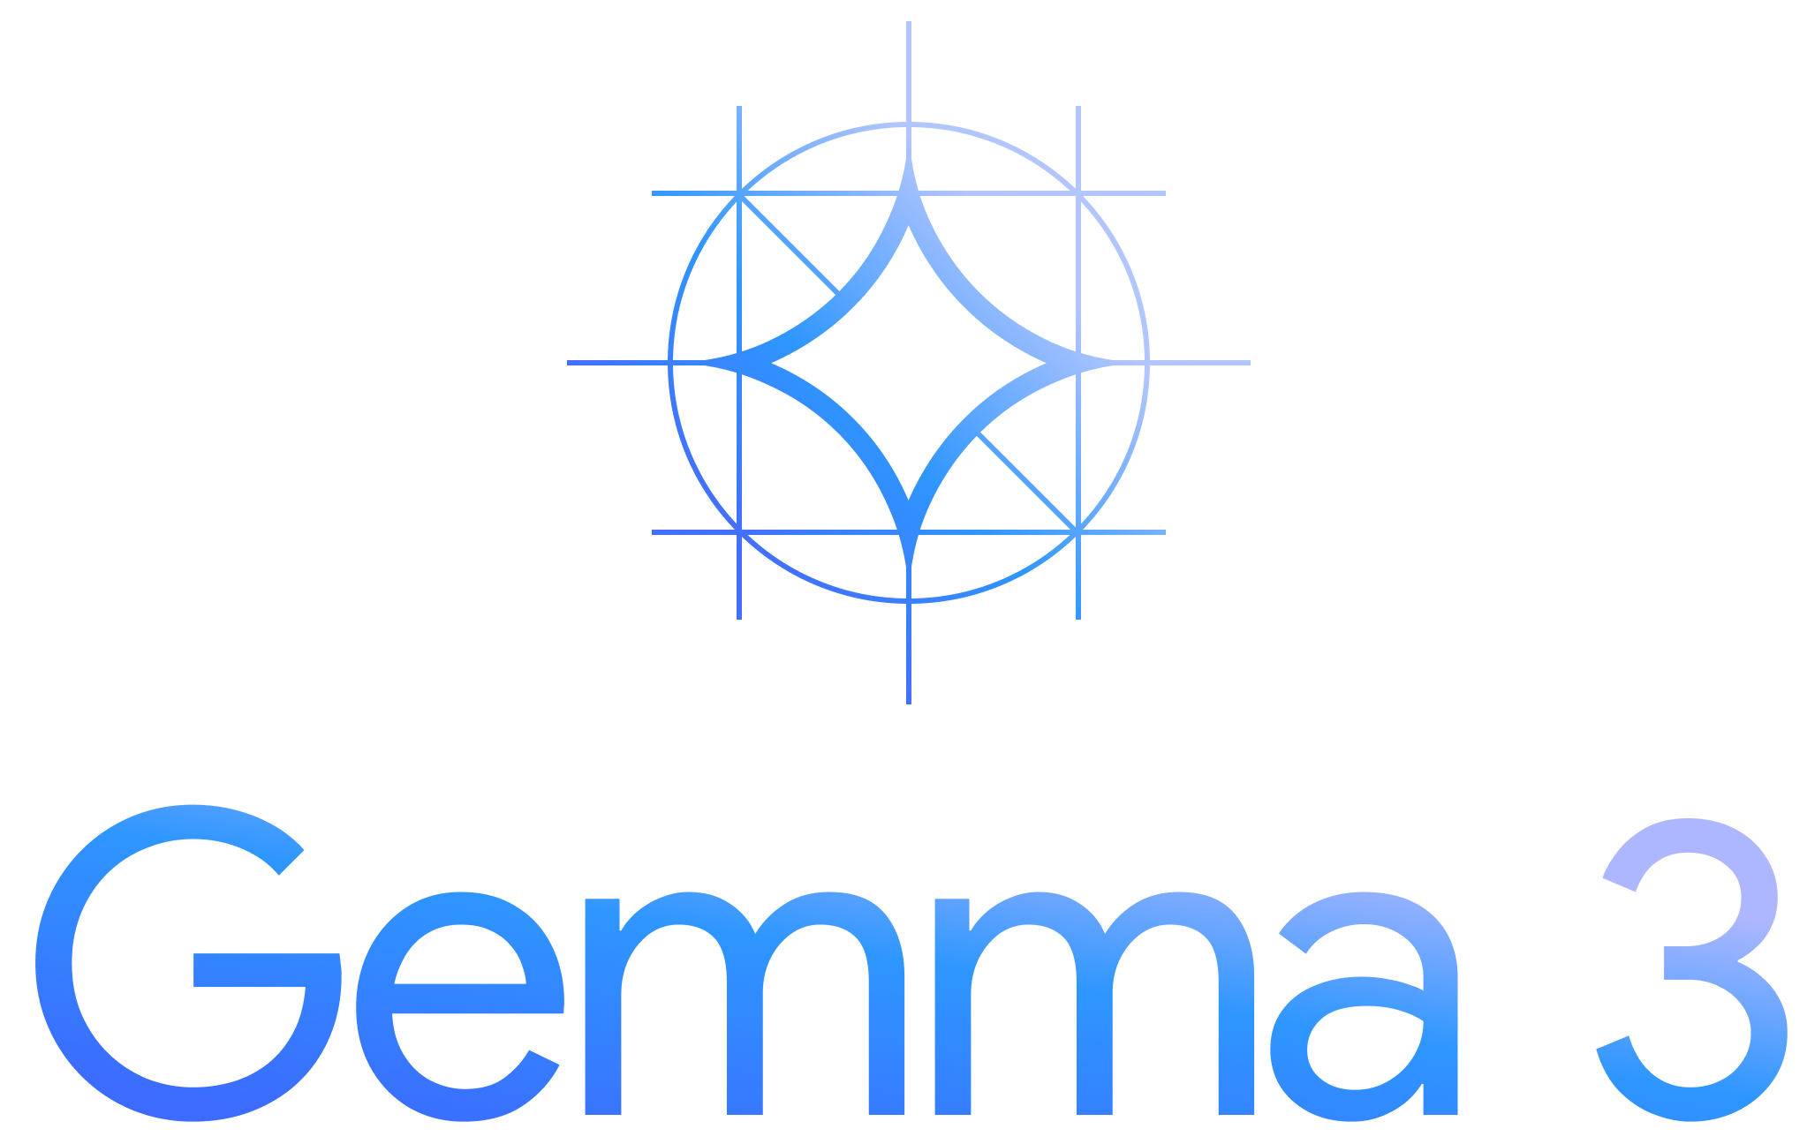
Vision Language Models & Gemma 3
Nitin Tiwari
Google Developer Expert – Machine Learning Associate Data Scientist @ Colgate-Palmolive

Slide 2
$whoami
Associate Data Scientist at Colgate-Palmolive India Ltd.
Google Developer Expert in Machine Learning
Contributor to Google Gemma/Gemini Cookbooks, TensorFlow.js, Google Dev Library
Technical Speaker (50+ talks across India and internationally)
Write blogs on AI/ML on Medium

Slide 3
Content
Introduction to Vision Language Models
Architecture of VLMs
What is PaliGemma?
Examples of PaliGemma
PaliGemma 2: What’s new?
Gemma 3
Resources for you to get started

Slide 4
Vision Language Models

Slide 5
Vision Language Models
Vision Language Models are multimodal models that learn from images and text, generating text outputs from image and text inputs.
They excel in zero-shot capabilities, generalization, and various tasks like image recognition, question answering, and document understanding.
These models can also capture spatial properties and output bounding boxes or segmentation masks for specific subjects.

Slide 6
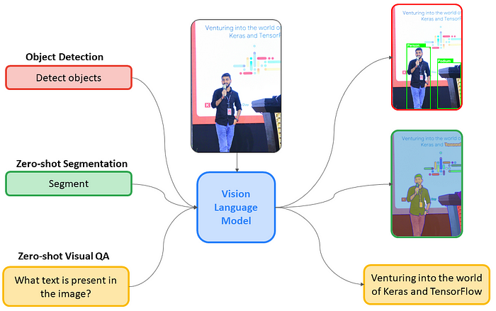
Vision Language Models

Slide 7

Architecture of VLMs
Text Output
Text Decoder
Text Decoder
Projected visual tokens + text embedded tokens
Multimodal Projector
Text Prompt
Image Encoder
Multimodal Projector
Text Prompt
{CLIP, SigLIP, etc.}
Frozen (not trainable)
Not frozen

Slide 8
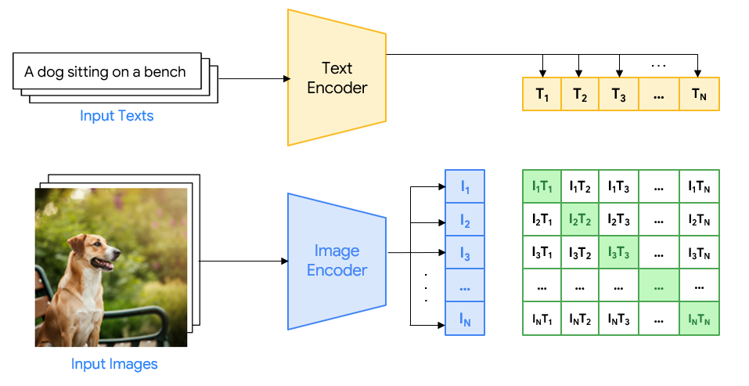
Example

Slide 9
Google’s open VLMs

Slide 10
Google’s open VLMs
PaliGemma
PaliGemma 2
Gemma 3
May’ 24
Dec’ 24
Mar’ 25
First open VLM
Supports multiple tasks
PT, FT, Mixed models
Gemma 2 decoder
More transfer tasks
Better accuracy
Longer token context window
140+ languages
On-device support

Slide 11
PaliGemma

Slide 12

PaliGemma
PaliGemma is an open Vision Language Model from Google with just 3B parameters designed to perform a variety of tasks such as image captioning, object detection, image segmentation, visual question & answering, optical character recognition, and more.
Inspired by PaLI-3, PaliGemma uses SigLIP (Sigmoid Loss for Language Image Pre-Training) as the image decoder and Gemma 2B as the underlying language model.
I’ll handle the vision capabilities
I’ll handle the text part
SigLIP (image encoder)
+
Gemma 2B (text decoder)
=

Slide 13
PaliGemma
PaliGemma is available in different variants:
Pre-trained model: The general purpose base model trained for a variety of tasks.
Fine-tuned model: Customized/fine-tuned for doing specific tasks.
Mixed model: A mixture of PT and FT PaliGemma models.
PaliGemma comes in 3 resolutions – 224x224, 448x448 and 896x896.
But… when do we need a fine-tuned model? 🤔

Slide 14
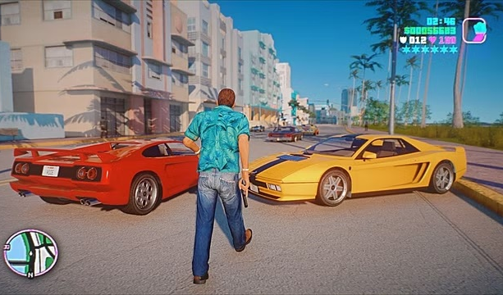
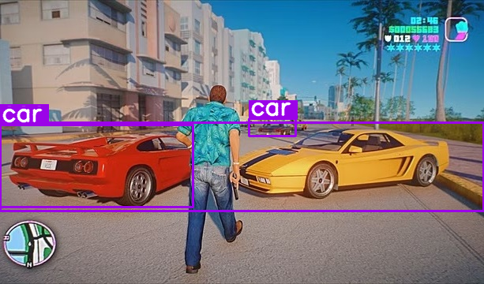

When do we need to fine-tune?
Prompt: Detect car Output
Pre-trained models are suited best for general purpose tasks. As long as the pre-trained model works well, there’s no need to fine-tune it.

Slide 15
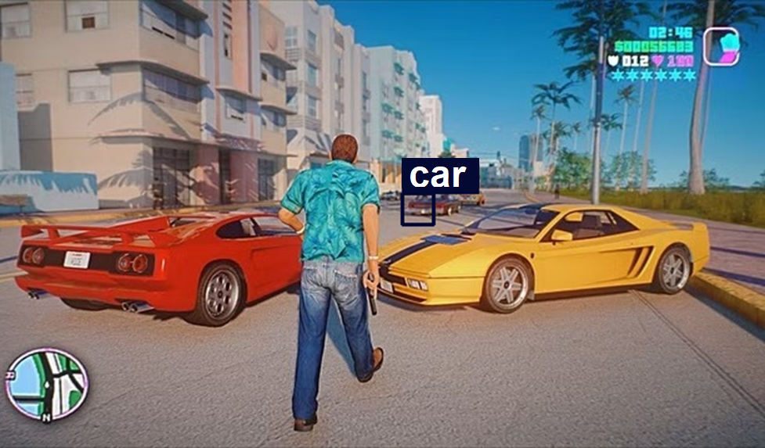

When do we need to fine-tune?
Prompt: Detect red car Output
Pre-trained model has failed to detect red cars specifically. So, we need to fine-tune it for this specific task.

Slide 16
Examples of PaliGemma * All the images/videos used are real, and tested without editing. *

Slide 17
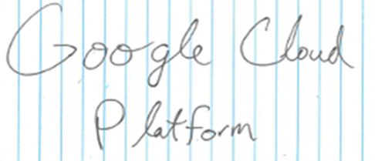
Visual Question & Answering
Given an image, PaliGemma can answer questions based on it.
Prompt: What is present in this image?
Response: Google Cloud Platform

Slide 18
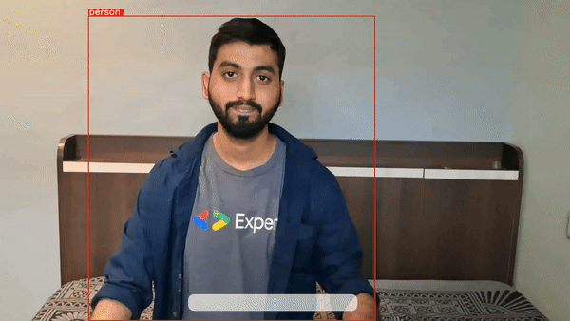
Zero-shot Object Detection
PaliGemma is capable of zero-shot object detection, meaning, without training the model on specific datasets, it can detect objects with just a text prompt.

Slide 19
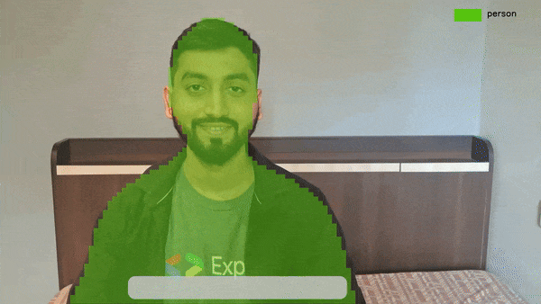
Instance Segmentation
PaliGemma can also segment objects in images and videos merely using a text prompt.

Slide 20
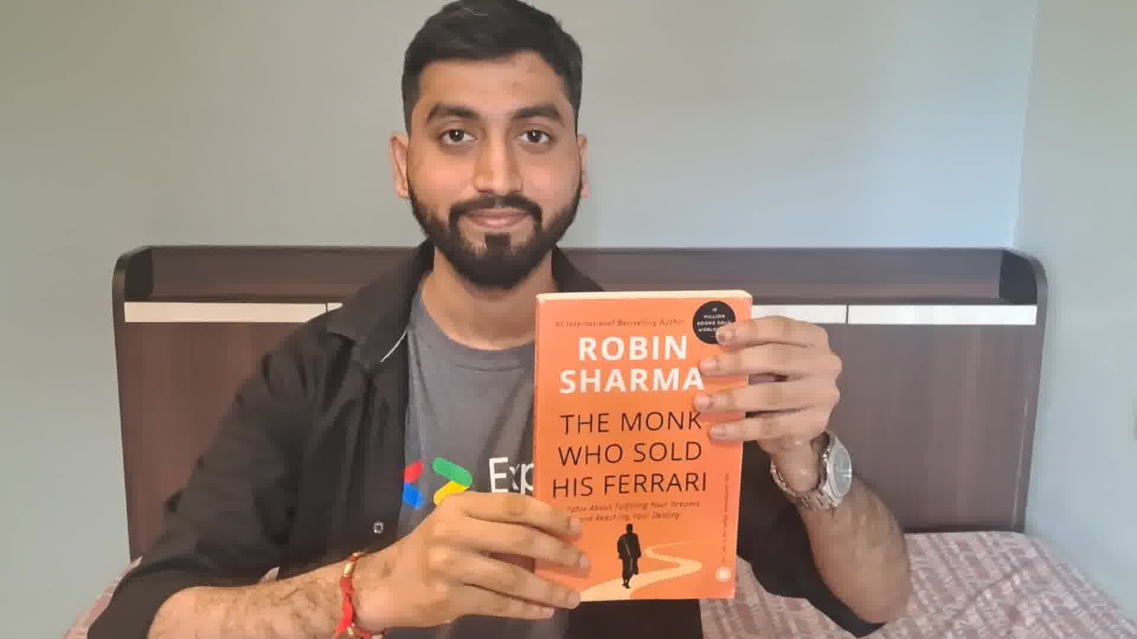
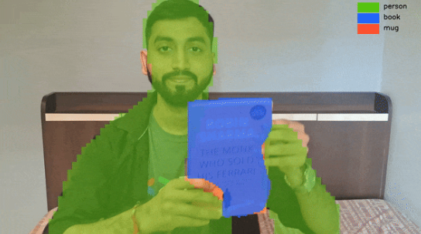
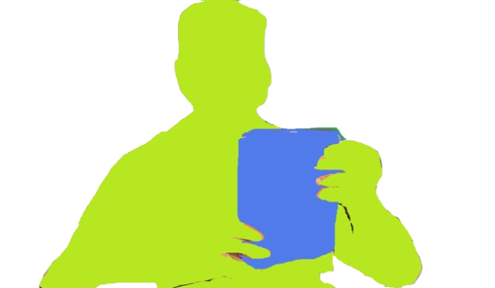
How does it work?
Text Prompt: Segment person, mug, book
<loc100><loc200><loc300><loc400><seg058><seg071> … person
Parse the output from PaliGemma model and draw segmentation mask on the input image.
<loc50><loc80><loc120><loc400><seg064><seg082> … book

Slide 21
Inference using Hugging Face 🤗 Transformers

Slide 22
Import libraries
Load pre-trained PaliGemma model
Give input image and text prompt
Pass the input to PaliGemma model
from transformers import AutoTokenizer, PaliGemmaForConditionalGeneration, PaliGemmaProcessor
import torch
device = torch.device("cuda" if torch.cuda.is_available() else "cpu")
model_id = "google/paligemma-3b-mix-448"
model = PaliGemmaForConditionalGeneration.from_pretrained(model_id, torch_dtype=torch.bfloat16) processor = PaliGemmaProcessor.from_pretrained(model_id)
input_image = Image.open(‘image.jpg’)
prompt = ‘’detect person’’
inputs = processor(text=input_text, images=input_image, padding="longest", do_convert_rgb=True, return_tensors="pt").to("cuda")
model.to(device)
inputs = inputs.to(dtype=model.dtype)

Slide 23
Get output
Parse the model response
with torch.no_grad():
output = model.generate(**inputs, max_length=496)
paligemma_response = processor.decode(output[0], skip_special_tokens=True)[len(input_text):].lstrip("\n") print(paligemma_response)
# Parse the PaliGemma model response as per need.
def parse_response(paligemma_response):
…..
…..
…..
Visual Question & Answering
Object Detection
Instance Segmentation
Image Captioning

Slide 24
What’s new in PaliGemma 2?

Slide 25
PaliGemma 2
Uses Gemma 2 as the language model, vision encoder (SigLIP) remains the same.
Available in 3B, 10B, 28B parameters size and (224 x 224), (448 x 448), (896 x 896) resolutions.
PaliGemma 2 generates detailed, contextually relevant captions for images.
Experimented on new set of transfer tasks:
Transfer Task | Dataset used
Table Structure Recognition | PubTabNet, FinTabNet
Chemical Molecular Structure Recognition | PubChem
Radiography Detection | GrandStaff
Music Score Recognition | MIMIC-CXR

Slide 26
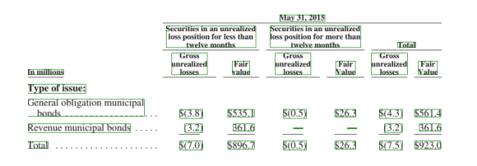
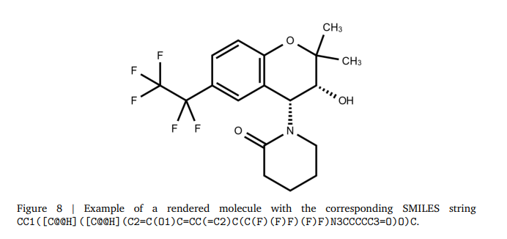
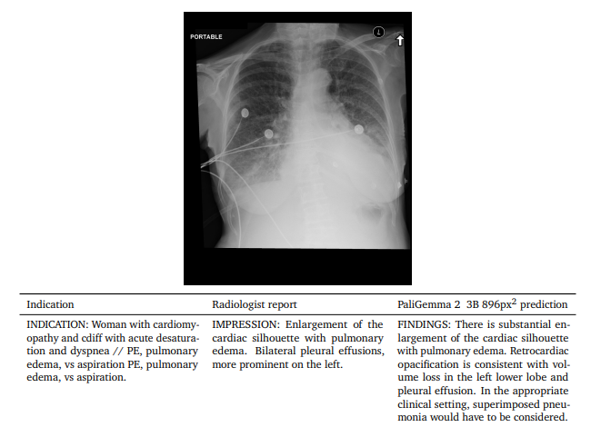
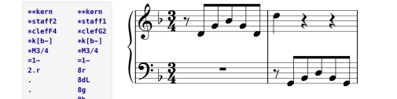
PaliGemma 2
Table Structure Recognition
Chemical Molecular Structure Recognition
Radiography Detection
Music Score Recognition

Slide 27
Hands-on: Run PaliGemma 2 on the browser using Transformers.js
Step 1: Clone the repository:
Step 2: Navigate to directory.
Step 3: Run to install the packages.
Step 4: Run to start the server.
Step 5: Open on your web browser and start inferencing PaliGemma 2.
* Read the Medium blog for step-by-step implementation of converting and quantizing PaliGemma 2 to ONNX and deploying on the browser for inference with Transformers.js:
https://medium.com/google-developer-experts/inference-paligemma-2-with-transformers-js-5545986ac14a
https://github.com/NSTiwari/PaliGemma2-ONNX-Transformers.js
PaliGemma2-ONNX-Transformers.js/Web App
npm install
node server.js
localhost:3000

Slide 28
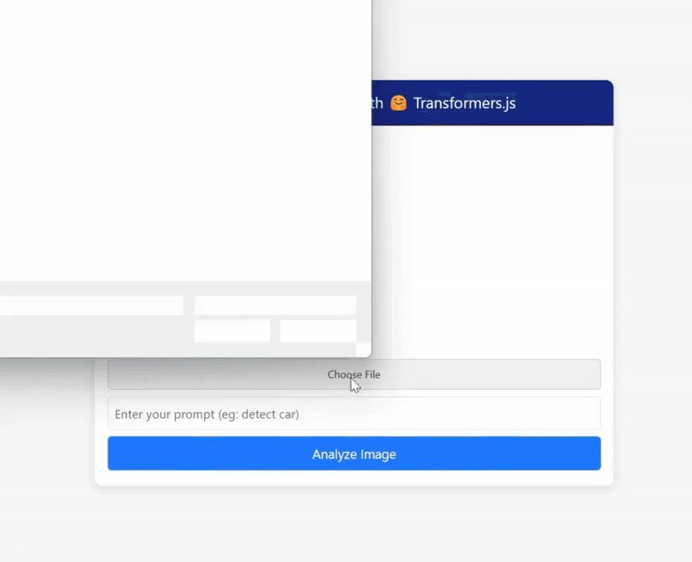
Hands-on: Run PaliGemma 2 on the browser using Transformers.js

Slide 29
Gemma 3

Slide 30
Gemma 3
Gemma 3 is the latest addition to Google’s open VLM family.
Supports both image and text input, unlike the previous Gemma models, which only supported text input.
Supported by Hugging Face Transformers, Ollama, Kaggle, JAX, Keras, PyTorch, Google AI Edge, and other 3P tools.
Learn more about Gemma 3 here - https://ai.google.dev/gemma/docs/core
Model | Modality | Multi-lingual Support | Token context window
gemma3-1b-it | Only text input | Only English | 32k
gemma3-4b-it | Text + image input | 140+ languages | 128k
gemma3-12b-it | Text + image input | 140+ languages | 128k
gemma3-27b-it | Text + image input | 140+ languages | 128k

Slide 31
Hands-on: Inference Gemma 3 on images and videos
Step 0: Ensure you have access to Gemma 3 model card on Hugging Face, and an HF Token with R/W access.
Step 1: Clone the repository:
Step 2: Open the notebook in Google Colab.
Step 3: Run the cells and inference on your own images and videos.
https://github.com/NSTiwari/nference-Gemma-3
Inference_images_and_videos_with_Gemma3.ipynb

Slide 32
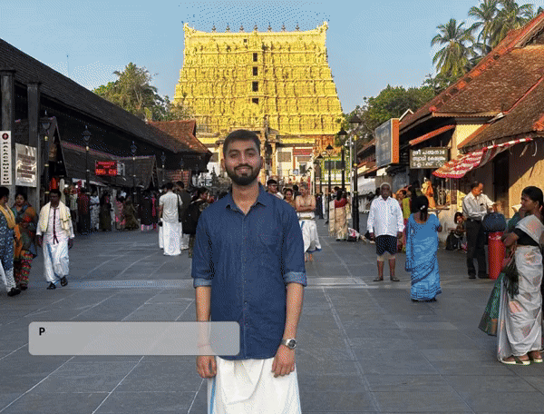
Hands-on: Inference Gemma 3 on images and videos

Slide 33
Resources

Slide 34
Resources
Vision Language Models: https://huggingface.co/blog/vlms
Gemma official documentation: https://ai.google.dev/gemma/
Gemma Cookbook: https://github.com/google-gemini/gemma-cookbook
PaliGemma Colab notebook examples: https://github.com/NSTiwari/PaliGemma
Inference PaliGemma 2 on the browser: https://github.com/NSTiwari/PaliGemma2-ONNX-Transformers.js
Inference Gemma 3 on images and videos: https://github.com/NSTiwari/Inference-Gemma-3

Slide 35





Thank You.
linkedin.com/in/tiwari-nitin
medium.com/@tiwarinitin1999
twitter.com/@NSTiwari21
github.com/NSTiwari

